Slide 1
Employee Data Analysis using Excel
STUDENT NAME: B.Thanuja
REGISTER NO:312216131&6D91655ECA7C02181684CC3A90193EAC
DEPARTMENT: Accounting And Finance
COLLEGE: Shri Shankarlal Sundarbai Shasun Jain College for Women.

Slide 2
PROJECT TITLE
Employee Performance Analysis using Excel

Slide 3


AGENDA
Problem Statement
Project Overview
End Users
Our Solution and Proposition
Dataset Description
Modelling Approach
Results and Discussion
Conclusion
3/21/2024 Annual Review

Slide 4

PROBLEM STATEMENT
Employees Performance analysis is an essential aspect of managing any business and, if done correctly, can help management teams use data analysis to their advantage to further business growth. Different crucial decisions like bonuses, pay raises, promotions, etc. are taken based on the performance evaluation of the employees in a company or organization. These are some reasons to analyse the employees performance level

Slide 5

PROJECT OVERVIEW
Analysing the performance level of employees considering various factors like gender, performance score, ratings, achievements and their contribution to the company. By this way we will be able to know how many employees are well-versed in their work and who needs improved, so that they can be motivated. This states the employees contribution level
.

Slide 6
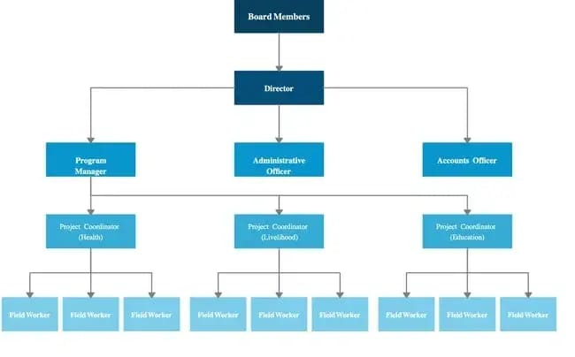

WHO ARE THE END USERS?
The end users of this analysis are board of directors, , management, shareholders , employers, employee ,etc.

Slide 7

OUR SOLUTION AND ITS VALUE PROPOSITION
Conditional formatting -to highlight missing values.
Filter -to remove those blanks/highlighted values.
Formula-IFS formula has been used to set the performance level.
Pivot table-to give a summary.
Graph-to understand the analysis easily.

Slide 8
Dataset Description
Employee data from Kaggle. 6 features were taken out of 26 features. Few features used in This projects are Employee, performance level, first and last name, employee rating, gender, business unit etc.

Slide 9

THE "WOW" IN OUR SOLUTION
Additional features are Performance level=IFs (Z8>=5"VERY HIGH", Z8>=4"HIGH", "Z8>=3"MED", T RUE", LOW")
3/21/2024 Annual Review
9

Slide 10
MODELLING
Data collection
Data set from Kaggle Features collection collected few features from it Data cleaning Used conditional formatting and removed the blanks by Filter option Performance level Identifed the employees performance level by creating a new formula summary summarized by use of Pivot tables Data Vizualization by Chart graph.
10

Slide 11
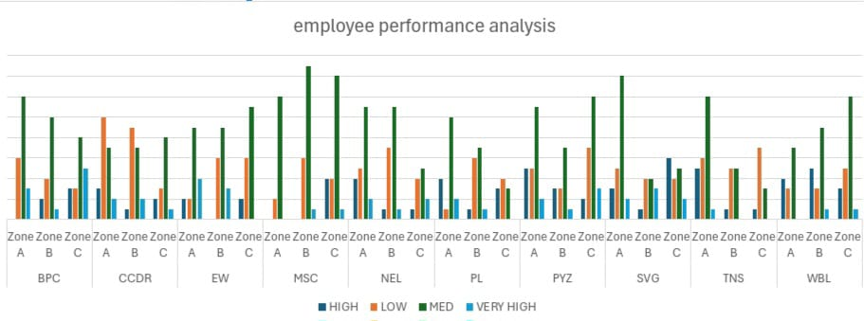
RESULTS
11

Slide 12
conclusion
And hence it is concluded that the MSC, with its production in Medium performance level is higher when compared with other departments

